Slide 1
Principles of Spectral Imaging
光谱成像原理

Slide 2
单点光谱扩展到光谱成像
From Single‑Point Spectroscopy to Spectral Imaging
Three Primary Spectral‑Imaging Acquisition Modes
光谱成像的主要模式
光谱分辨率与空间分辨率及其权衡
Trade‑off Between Spatial Resolution and Spectral Resolution
多光谱与高光谱
Multispectral and hyperspectral

Slide 3
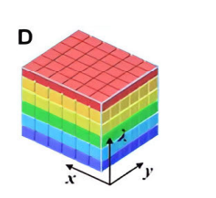
From Single‑Point Spectroscopy to Spectral Imaging
Conventional single‑point spectroscopy only obtains spectral information at one fixed spatial location: it answers “what” material the target is.
- Traditional 2‑D imaging only records spatial information: it answers “where” the object is located.
- Spectral imaging combines spectroscopy and imaging, generating a 3‑D spectral data cube I(x,y,λ). It answers: where is what.
- The data cube contains two spatial dimensions (x,y) and one spectral dimension (λ).

Slide 4
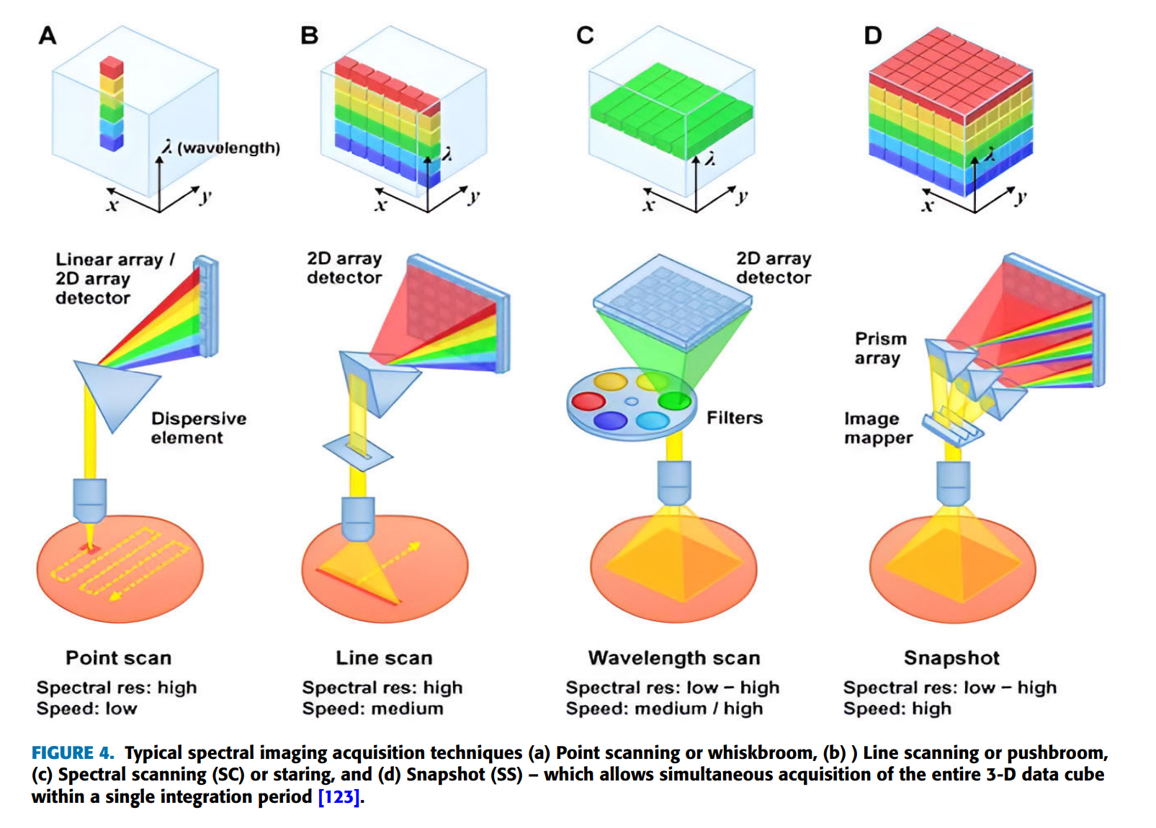
Whiskbroom Mode (Point‑Scanning，扫帚式 / 点扫描)
Optical path: Scanning mirror moves across scene, one spatial point at a time. Each single point acquires its complete full spectrum. Build cube by scanning every pixel point‑by‑point.
✅ Pros: High spectral quality for each sampled point; good SNR.
❌ Cons: Two‑axis mechanical scanning; long acquisition time; moving‑part artifacts.
Pushbroom Mode (Line‑Scanning，推扫式 / 线扫描)
Optical path: Simultaneously captures an entire line of spatial information plus full spectrum for each pixel on that line. Complete 2‑D spatial area is obtained via relative platform motion (aircraft / satellite / translation stage).
✅ Pros: Much faster than whiskbroom; widely used in remote sensing.
❌ Cons: Depends on steady relative movement between sensor and target.

Slide 5
Staring Mode (Spectral Scanning，凝视式 / 光谱扫描)
Optical path: Keep the whole scene stationary on detector; use tunable optical filters (AOTF, LCTF, FPI, LVF) to sequentially select one wavelength band. Stack series of 2‑D images to reconstruct the full 3‑D data cube.
✅ Pros: Captures full‑field scene for each wavelength; no spatial mechanical scanning.
❌ Cons: Wavelength scanning takes time; poor performance for dynamic moving scenes.

Slide 6
Trade‑off Between Spatial Resolution and Spectral Resolution
- In conventional spectral‑imaging optical systems, there exists an intrinsic trade‑off between spatial resolution and spectral resolution [Mukhtar et al., 2025].
- Higher spectral resolution requires more, narrower spectral bands. Under limited photon budget and detector constraints, this often sacrifices spatial sampling performance.
- If you pursue fine spatial details (high spatial resolution), the number of available spectral channels will be limited.
- Advanced approaches such as snapshot imaging and compressive computational imaging can mitigate this conflict, but cannot completely eliminate the fundamental physical limits from photon availability.

Slide 7
MULTISPECTRAL IMAGING
多光谱成像
By capturing and analyzing how objects reflect, absorb, or emit light across different spectral bands, MSI uncovers information about the composition, structure, and properties of a scene or object.

Slide 8
HYPERSPECTRAL IMAGING
高光谱成像
While MSI systems have long provided a balance between spectral information and ease of implementation, the HSI systems have pushed the boundaries in terms of providing deep spectral insight.

Slide 9
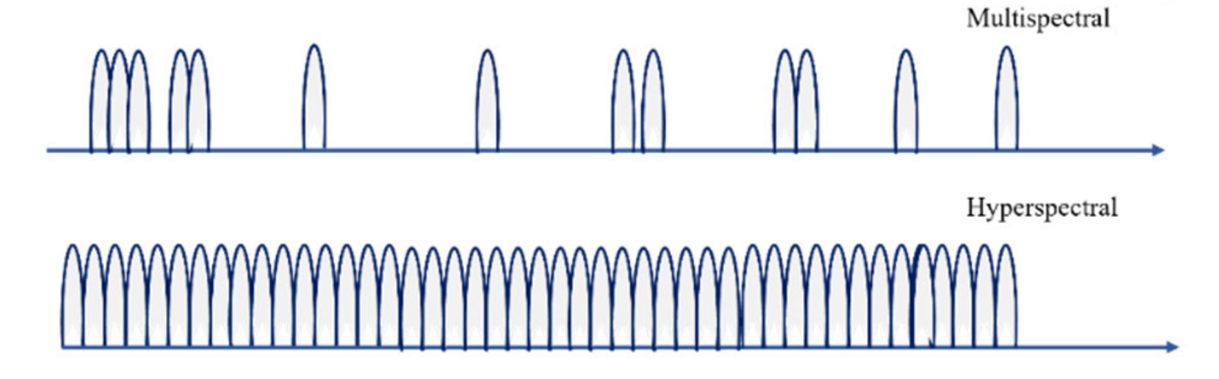
Multispectral Imaging VS Hyperspectral Imaging
 | Multispectral Imaging 多光谱成像 | Hyperspectral Imaging 高光谱成像
Spectral bands 光谱波段 | Discrete widely‑spaced bands (typically 3‑25 bands) | Hundreds of contiguous narrow spectral bands
Spectral signature 光谱特征 | Coarse spectral sampling Dense | continuous spectral fingerprint per pixel
Data volume 数据量 | Small, easy to process | Large 3‑D data cube heavy computation load
Typical strength 优势 | Higher spatial / temporal resolution; low cost | Fine material discrimination by continuous spectrum

